Slide 1
SOFE 3650 – Software Architecture Design Analysis
Notes created from:
“Software Architecture: Foundations, Theory, and Practice,” Chapter 8, Taylor et al and
“Designing Software Architectures- A practical Approach”, Chapter 8, H. Cervantes and R. Kazman.

Slide 2
What Is Architectural Analysis?
Architectural analysis is the activity of discovering important system properties using the system’s architectural models.
Early, useful answers about relevant architectural aspects
Available prior to system’s construction
Important to know
which questions to ask
why to ask them
how to ask them
how to ensure that they can be answered

Slide 3
Informal Architectural Models and Analysis
Helps architects get clarification from system customers
Helps managers ensure project scope
Not as useful to developers
Software Architecture: Foundations, Theory, and Practice; Richard N. Taylor, Nenad Medvidovic, and Eric M. Dashofy; © 2008 John Wiley & Sons, Inc. Reprinted with permission.

Slide 4
Reading Exercise
Read the section titled “I Believe” Isn’t Good Enough taken from Cervantes et al.
Why is “I believe” not good enough?

Slide 5
Formal Architectural Models and Analysis
Component UserInterface
Port getValues
Port calculate
Computation
Connector Call
Role Caller =
Role Callee =
Glue =
Configuration LunarLander
Instances
DS : DataStore
C : Calculation
UI : UserInterface
CtoUIgetValues, CtoUIstoreValues, UItoC, UItoDS : Call
Attachments
C.getValues as CtoUIgetValues.Caller
DS.getValues as CtoUIgetValues.Callee
C.storeValues as CtoUIstoreValues.Caller
DS.storeValues as CtoUIstoreValues.Callee
UI.calculate as UItoC.Caller
C.calulate as UItoC.Callee
UI.getValues as UItoDS.Caller
DS.getValues as UItoDS.Callee
End LunarLander.
Helps architects determine component composability
Helps developers with implementation-level decisions
Helps with locating and selecting appropriate OTS components
Helps with automated code generation
Not as useful for discussions with non-technical stakeholders
Software Architecture: Foundations, Theory, and Practice; Richard N. Taylor, Nenad Medvidovic, and Eric M. Dashofy; © 2008 John Wiley & Sons, Inc. Reprinted with permission.

Slide 6
Concerns Relevant to Architectural Analysis
Goals of analysis
Scope of analysis
Primary architectural concern being analyzed
Level of formality of architectural models
Type of analysis
Level of automation
System stakeholders interested in analysis

Slide 7
Architectural Analysis Goals
The four “C”s
Completeness
Consistency
Compatibility
Correctness

Slide 8
Architectural Analysis Goals – Completeness
Completeness is both an external and an internal goal
It is external with respect to system requirements
Challenged by the complexity of large systems’ requirements and architectures
Challenged by the many notations used to capture complex requirements as well as architectures
It is internal with respect to the architectural intent and modeling notation
Have all elements been fully modeled in the notation?
Have all design decisions been properly captured?

Slide 9
Architectural Analysis Goals – Consistency
Consistency is an internal property of an architectural model
Ensures that different model elements do not contradict one another
Dimensions of architectural consistency
Name
Interface
Behavior
Interaction
Refinement

Slide 10
Name Consistency
Component and connector names
Component service names
May be non-trivial to establish at the architectural level
Multiple system elements/services with identical names
Loose coupling via publish-subscribe or asynchronous event broadcast
Dynamically adaptable architectures

Slide 11
Interface Consistency
Encompasses name consistency
Also involves parameter lists in component services
A rich spectrum of choices at the architectural level
Example: matching provided and required interfaces
ReqInt: getSubQ(Natural first, Natural last, Boolean remove)
returns FIFOQueue;
ProvInt1: getSubQ(Index first, Index last)
returns FIFOQueue;
ProvInt2: getSubQ(Natural first, Natural last, Boolean remove)
returns Queue;

Slide 12
Behavioral Consistency
Names and interfaces of interacting components may match, but behaviors need not
Example: subtraction
subtract(Integer x, Integer y) returns Integer;
Can we be sure what the subtract operation does?
Example: QueueClient and QueueServer components
QueueClient
precondition q.size > 0;
postcondition ~q.size = q.size;
QueueServer
precondition q.size > 1;
postcondition ~q.size = q.size - 1;

Slide 13
Interaction Consistency
Names, interfaces, and behaviors of interacting components may match, yet they may still be unable to interact properly
Example: QueueClient and QueueServer components
Software Architecture: Foundations, Theory, and Practice; Richard N. Taylor, Nenad Medvidovic, and Eric M. Dashofy; © 2008 John Wiley & Sons, Inc. Reprinted with permission.

Slide 14
Refinement Consistency
Architectural models are refined during the design process
A relationship must be maintained between higher and lower level models
All elements are preserved in the lower level model
All design decisions are preserved in the lower-level model
No new design decisions violate existing design decisions

Slide 15
Refinement Consistency Example
Software Architecture: Foundations, Theory, and Practice; Richard N. Taylor, Nenad Medvidovic, and Eric M. Dashofy; © 2008 John Wiley & Sons, Inc. Reprinted with permission.

Slide 16
Architectural Analysis Goals – Compatibility
Compatibility is an external property of an architectural model
Ensures that the architectural model adheres to guidelines and constraints of
a style
a reference architecture
an architectural standard

Slide 17
Architectural Compatibility Example – Lunar Lander
Software Architecture: Foundations, Theory, and Practice; Richard N. Taylor, Nenad Medvidovic, and Eric M. Dashofy; © 2008 John Wiley & Sons, Inc. Reprinted with permission.

Slide 18
Architectural Analysis Goals – Correctness
Correctness is an external property of an architectural model
Ensures that
the architectural model fully realizes a system specification
the system’s implementation fully realizes the architecture
Inclusion of OTS elements impacts correctness
System may include structural elements, functionality, and non-functional properties that are not part of the architecture
The notion of fulfillment is key to ensuring architectural correctness

Slide 19
Scope of Architectural Analysis
Component- and connector-level
Subsystem- and system-level
Beware of the “honey-baked ham” syndrome
Data exchanged in a system or subsystem
Data structure
Data flow
Properties of data exchange
Architectures at different abstraction levels
Comparison of two or more architectures
Processing
Data
Interaction
Configuration
Non-functional properties

Slide 20
Data Exchange Example
Software Architecture: Foundations, Theory, and Practice; Richard N. Taylor, Nenad Medvidovic, and Eric M. Dashofy; © 2008 John Wiley & Sons, Inc. Reprinted with permission.

Slide 21
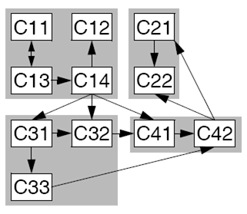
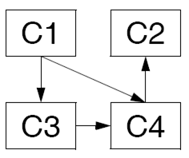
Architectures at Different Abstraction Levels
Software Architecture: Foundations, Theory, and Practice; Richard N. Taylor, Nenad Medvidovic, and Eric M. Dashofy; © 2008 John Wiley & Sons, Inc. Reprinted with permission.

Slide 22
Architectural Concern Being Analyzed
Structural characteristics
Behavioral characteristics
Interaction characteristics
Non-functional characteristics

Slide 23
Level of Formality
Informal models
Semi-formal models
Formal models

Slide 24
Type of Analysis
Static analysis
Dynamic analysis
Scenario-driven analysis
Can be both static and dynamic

Slide 25
Level of Automation
Manual
Partially automated
Fully automated

Slide 26
Analysis Stakeholders
Architects
Developers
Managers
Customers
Vendors

Slide 27
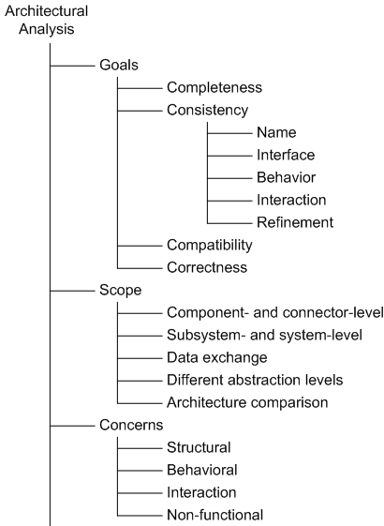
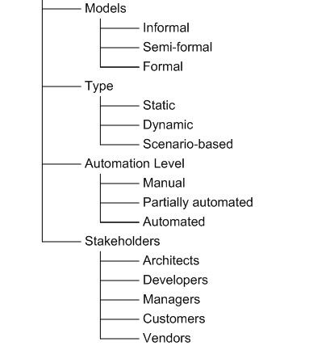
Architectural Analysis in a Nutshell
Software Architecture: Foundations, Theory, and Practice; Richard N. Taylor, Nenad Medvidovic, and Eric M. Dashofy; © 2008 John Wiley & Sons, Inc. Reprinted with permission.

Slide 28
Analysis Techniques

Slide 29
Architectural Inspections and Reviews
We will focus on the inspections and reviews process for analysis relying on several different techniques.
Architectural models studied by human stakeholders for specific properties
The stakeholders define analysis objective
Manual techniques
Can be expensive
Useful in the case of informal architectural descriptions
Useful in establishing “soft” system properties
E.g., scalability or adaptability
Able to consider multiple stakeholders’ objectives and multiple architectural properties

Slide 30
Inspections and Reviews in a Nutshell
Analysis Goals – any
Analysis Scope – any
Analysis Concern – any, but particularly suited for non-functional properties
Architectural Models – any, but must be geared to stakeholder needs and analysis objectives
Analysis Types – mostly static and scenario-based
Automation Level – manual, human intensive
Stakeholders – any, except perhaps component vendors

Slide 31
Architecture Analysis Techniques
Analytic models:
Well-established mathematical models allow you to study quality attributes such as performance or availability.
Checklists:
Checklists are useful tools that allow you to ensure in a systematic way that certain decisions that need to be taken into account are not forgotten.
Thought experiments, reflective questions, and back-of-the-envelope analyses:
Thought experiments are informal analyses performed by a small group of designers in which important scenarios are studied to identify potential problems.
Prototypes, simulations, and experiments:
Purely conceptual techniques for analyzing a design are sometimes inadequate to accurately understand whether certain design decisions are appropriate, or whether you should favor one particular technology over another.

Slide 32
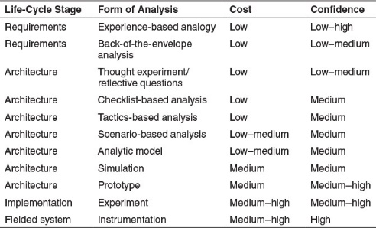
Architecture Analysis Techniques

Slide 33
Tactics-Based Analysis
This technique takes advantage of tactics that can used to achieve desired qualities.
Many of these tactics are listed in the appendix of Cervantes et al. book.
They can also be used to help come up with questions when analyzing an architecture.
For example the Availability tactic.

Slide 34
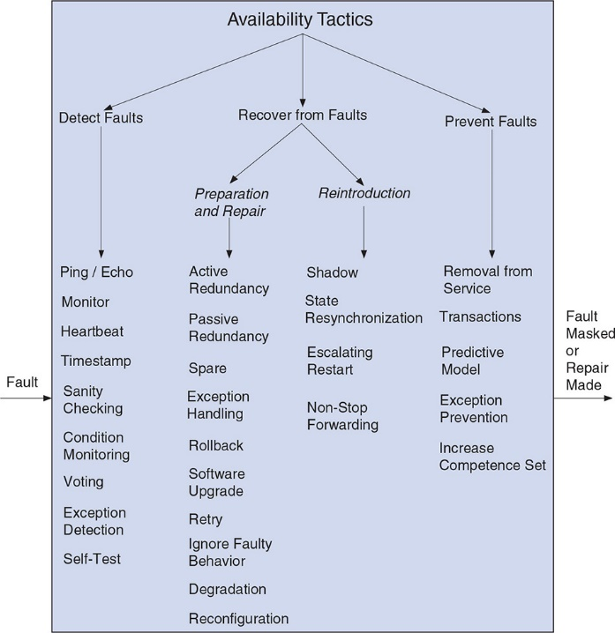
Availability Tactic - Example
Recap:
This is an ontology of availability improvement techniques.
seven most important system quality attributes—availability, interoperability, modifiability, performance, security, testability, and usability are covered in Bass et al book in Software Architecture

Slide 35
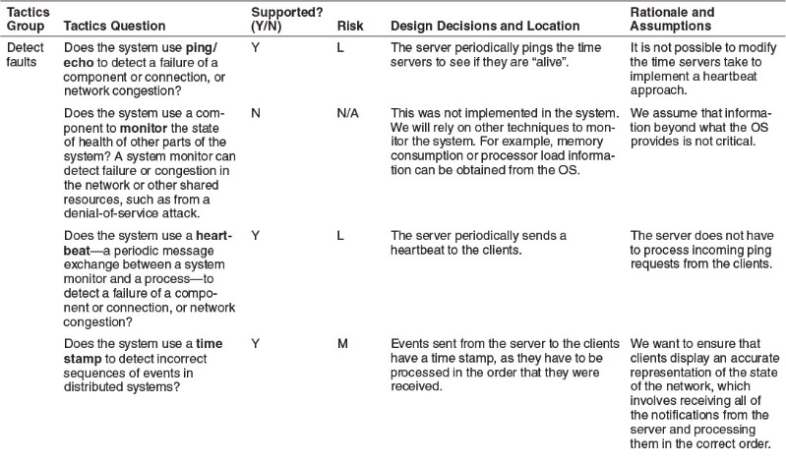
Questions Created from the Attributes Tactic for the FCAPS Example

Slide 36
Questions that can be asked in an Analysis Review
Whether there are any obvious risks in the use (or nonuse) of this tactic?
How it is realized in the system?
Where in the code base the implementation (realization) may be found?
Any rationale or assumptions made in the realization of this tactic.
A set of “tactic” based questions are listed in Appendix B of Cervantes’ book.

Slide 37
Reflective Questions
Reflective questions help to uncover design biases in a systematic way, which can lead us to revise our assumptions and hence our designs.
They can be used to reflect on context and requirements (Are the contexts and requirements identified relevant, complete, and accurate?), design problems (Have they been properly and fully articulated?), design solutions (Are they appropriate given the requirements?), and design decisions (Are they principled and justified?).

Slide 38
Scenario-based Reviews
Comprehensive scenario-based design reviews, such as the ATAM, have typically been conducted outside the design process.
When an architect or other key stakeholder believed that there was enough of an architecture or architecture description to analyze, an ATAM meeting could be convened.

Slide 39
Example – ATAM
Stands for Architectural Trade-off Analysis Method
Human-centric process for identifying risks early on in software design
Focuses specifically on four quality attributes (NFPs)
Modifiability
Security
Performance
Reliability
Reveals how well an architecture satisfies quality goals and how those goals trade-off

Slide 40
ATAM Process
The ATAM brings together three groups in an evaluation:
A trained evaluation team
An architecture’s “decision makers”
Representatives of the architecture’s stakeholders
The ATAM helps stakeholders ask the right questions to discover potentially problematic architectural decisions—that is, risks.
These discovered risks can then be made the focus of mitigation activities such as further design, further analysis, prototyping, and implementation.
It is not a deep precise form of analysis!!!

Slide 41
ATAM Steps
An ATAM evaluation takes place in four phases. The first phase (phase 0) and the final phase (phase 3) are managerial: setting up the evaluation at the start and reporting results and follow-on activities at the end. The middle phases (phases 1 and 2) are when the actual analysis takes place. The steps enacted in phases 1 and 2 are as follows:
Present the ATAM
Present the business drivers
Present the architecture
Identify the architectural approaches
Generate a quality attribute utility tree
Analyze the architectural approaches
Brainstorm and prioritize scenarios
Analyze the architectural approaches
Present the results

Slide 42
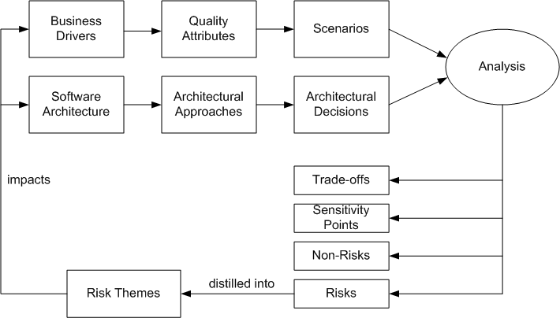
ATAM Process
Software Architecture: Foundations, Theory, and Practice; Richard N. Taylor, Nenad Medvidovic, and Eric M. Dashofy; © 2008 John Wiley & Sons, Inc. Reprinted with permission.

Slide 43
ATAM Phases
Phase 1:
Enact steps 1–6 with a small, internal group of stakeholders—typically just the architect, project manager and perhaps one or two senior developers.
Phase 2:
Invite a larger group of stakeholders to attend—all the people who attended phase 1 plus external stakeholders, such as customer representatives, end-user representatives, quality assurance, operations, and so forth.
Review steps 1–6 and enact steps 7–9.

Slide 44
ATAM Business Drivers
The system’s critical functionality
Any technical, managerial, economic, or political constraints
The project’s business goals and context
The major stakeholders
The principal quality attribute (NFP) goals

Slide 45
ATAM Scenarios
Use-case scenarios
Describe how the system is envisioned by the stakeholders to be used
Growth scenarios
Describe planned and envisioned modifications to the architecture
Exploratory scenarios
Try to establish the limits of architecture’s adaptability with respect to
system’s functionality
operational profiles
underlying execution platforms
Scenarios are prioritized based on importance to stakeholders

Slide 46
ATAM Architecture
Technical constraints
Required hardware platforms, OS, middleware, programming languages, and OTS functionality
Any other systems with which the system must interact
Architectural approaches that have been used to meet the quality requirements
Sets of architectural design decisions employed to solve a problem
Typically architectural patterns and styles

Slide 47
ATAM Analysis
This is the key step in ATAM
Objective is to establish relationship between architectural approaches and quality attributes
For each architectural approach a set of analysis questions are formulated
Targeted at the approach and quality attributes in question
System architects and ATAM evaluation team work together to answer these questions and identify
Risks → these are distilled into risk themes
Non-Risks
Sensitivity points
Trade-off points
Based on answers, further analysis may be performed

Slide 48
Comments on ATAM and the Software Process
Today, most software organizations are practicing some form of Agile or iterative development. There is no distinct monolithic “architecture phase” in Agile processes.
architecture and development are co-created in a series of sprints.

Slide 49
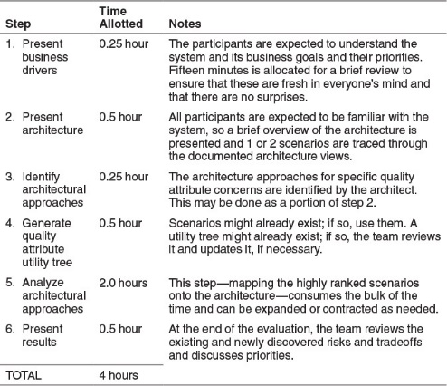
Lightweight ATAM
Can be conducted in a half-day meeting. It can also be carried out internally, using just project members.

Slide 50
ATAM in a Nutshell
Goals | Completeness Consistency Compatibility Correctness`
Scope | Subsystem- and system-level Data exchange
Concern | Non-functional
Models | Informal Semi-formal
Type | Scenario-driven
Automation Level | Manual
Stakeholders | Architects Developers Managers Customers
Software Architecture: Foundations, Theory, and Practice; Richard N. Taylor, Nenad Medvidovic, and Eric M. Dashofy; © 2008 John Wiley & Sons, Inc. Reprinted with permission.

Slide 51
ATAM in-class exercise

